Slide 1
A Tool to Integrate ChIP-seq and RNA-seq Datasets
Jenny Smith
BIOF309
May 4, 2016

Slide 2
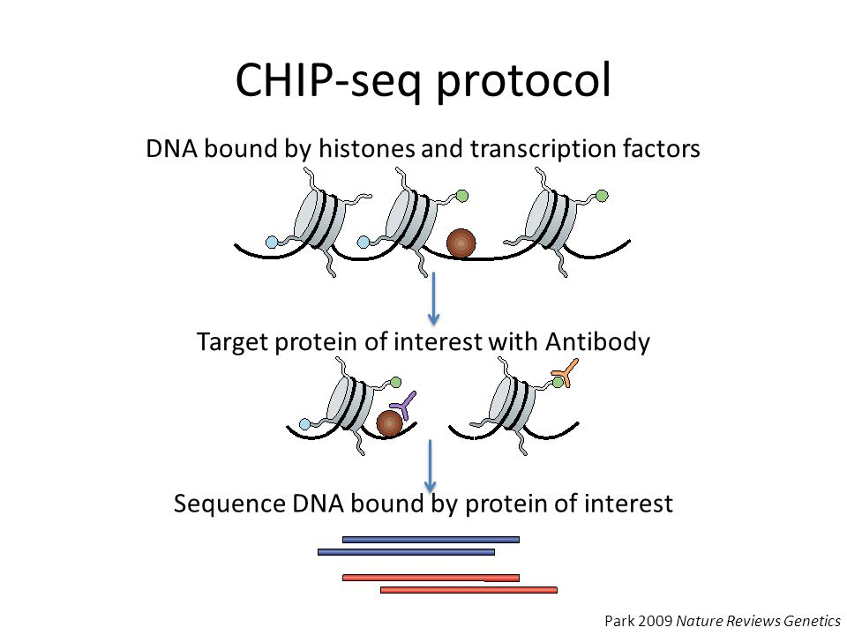
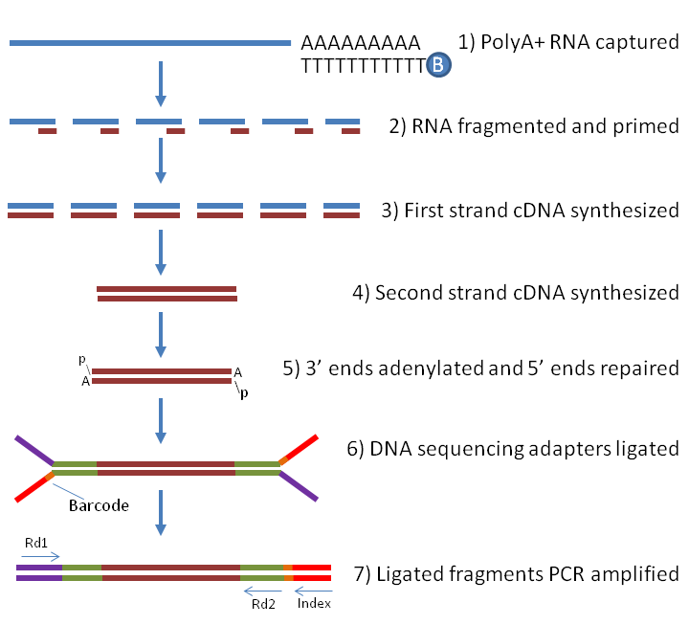
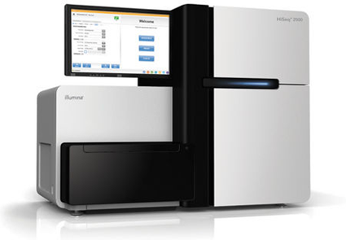
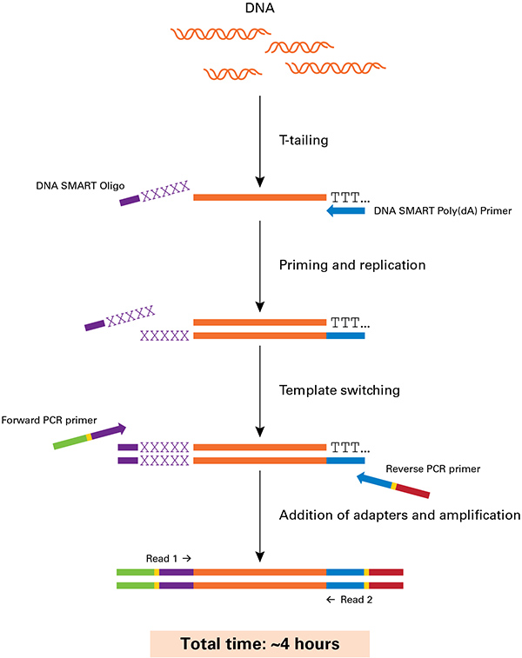
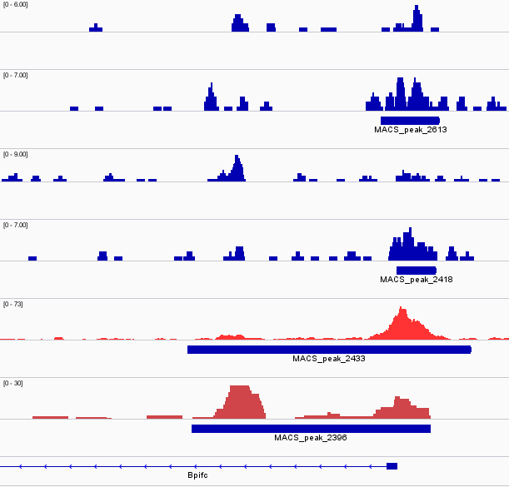
Background
Chromatin Immunoprecipitation and Sequencing (ChIP- Seq)
RNA Extraction followed by Sequencing (RNA- Seq)
Illumina HiSeq 2500
Isolated mRNA + oligodT
First strand cDNA synthesis
Second strand cDNA synthesis
Adaptor ligation
Adaptor ligation
ChIP-seq
DLX3
PEAK = TF Binding
Adapted from Park, Nature Reviews Genetics, 2009.
Bpifc
Notes:
BIG PICTURE:
Is a transcription factor (TF) binding associated with differential gene expression at specific gene locus?
http://www.biotech.cornell.edu/brc/genomics-facility/services/instruments
http://www.labome.com/method/RNA-seq-Using-Next-Generation-Sequencing.html
https://www.westburg.eu/products/genomics-research/next-generation-sequencing/dna-sequencing/chip-seq/chip-seq-kit

Slide 3
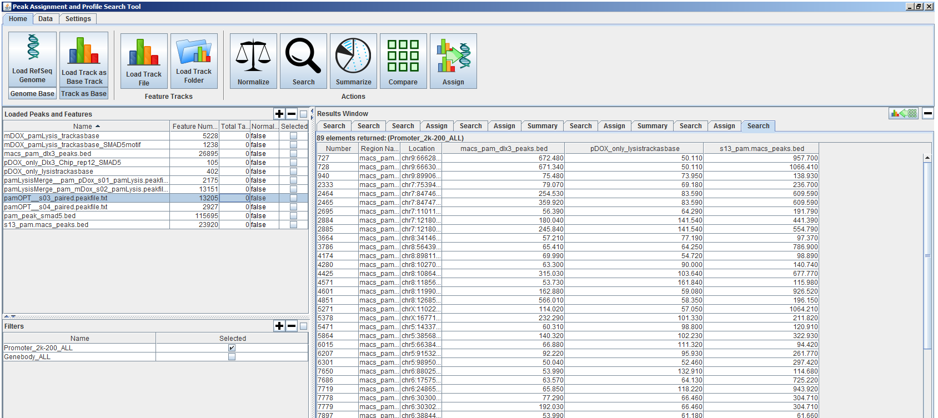
Introduction
PAPST – ChIP-seq Peak Co-localization and Annotation Tool
Input peak files here
TF binding
Histone Modifications
Search Results
Export CSV
List of co- localized peaks
Filters here
Promoter
Distance from TSS
Notes:
describe how you have ChIP-seq from a cell line and tissue (pam vs SB)
If I had done cell line and the tissue at different times, you would have to input the files back into papst to create a csv file with both files right? Time consuming – BE SURE TO Emphasize that this is colocalization of multiple chip-seq tracks
These peaks in both cell line and tissue are the “highest confidence” peaks – most likely to be true binding sites of TF

Slide 4
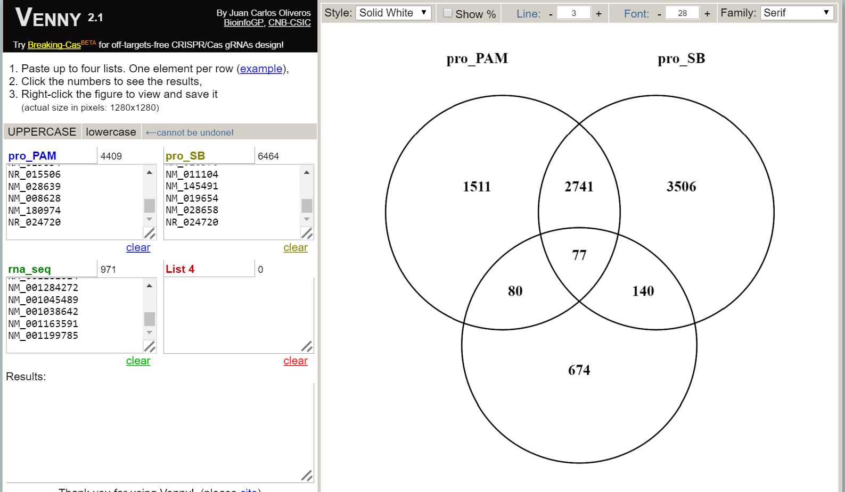
Introduction
want to determine if our TF of interest binding to a gene locus could have an effect on its transcriptional regulation
Previously, used venny – show screen shot venny
then only had a list of gene accessions – lost all information about the exact location of the peak and the fold-change. Have to continuously look through three or four excel sheets to find this infor and copy paste
list of gene accessions only – lost all other information.
Manually had to search through multiple CSV files to find fold-change, peak locations, etc.

Slide 5
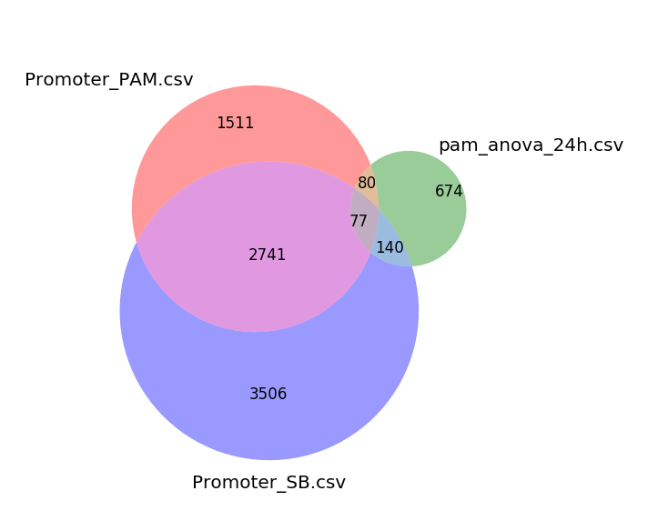
Peaks_DEG Command Line Tool
Peaks = ChIP-Seq peaks
DEG = differentially expressed genes
Finds the overlapping peaks in two separate PAPST peak files, then identifies if these genes are also differentially expressed in an RNA-seq dataset (CSV file format).
Output: Produces a csv file with the peak location, fold-change, p-value and q-values from RNA-seq data
also produces a Venn diagram that is weighted by area that can be used in presentations, etc.
Notes:
Demo here

Slide 6
Peaks_DEG Command Line Tool
Benefits
no need to re-do analysis on PAPST with multiple peak files
all information is retained during the overlapping/merging of data files
Much quicker
Future Directions
Merging based on file header – so really limited to only PAPST csv files and RNA-seq files from NIAMS pipeline
would need to have a user edit the code for different input files
User must filter and sort RNA-seq data by q-value and fold-change cutoffs (e.g. q<0.05 and FC>2) before getting meaningful information
output will include the other lists of overlap from the Venn diagram.

